Slide 1


(Remote Workflow Manager)
Team Member:-
Heet Jhaveri [IU1682820012]
Dhrumit Kansara [IU1682820013]
Internal Guide:- Dr. Vishal Dahiya

Slide 2
Our Profile
We are students of IMCA Semester 9
We are going to develop this allRemote (Remote Work Flow Manager) to minimize the effort of managing team remotely.
allRemote

Slide 3
Synopsis
Abstract
allRemote connects your team so you can continue to collaborate, manage and track work in one easy-to-use platform, wherever you are.
Name of the Project: allRemote (Remote Work Flow Manager)
Objectives:
Where working remote feels breeze
Align teams quickly
Bring out the best in your remote teams
allRemote

Slide 4
Features
Task Management: We can create/manage tasks easily for the team. And assign the team member for specific task to get tasks done.
Schedule: Team can be updated with the schedules of meetings and events.
Team Members: Know your team better assign with you on your project.
Wall: Share your thoughts and ideas with your teammates.
Location & Time: While working remotely it is not necessary that your team is in the same location which you are, so with this you can know the location & local time of your team mates.
Reminder: Get notified for the assigned tasks via email.
allRemote

Slide 5
Users
The system has various modules:
Administrator
Project Manager
Team Member
1. Administrator: The Admin can perform various functions
  Manage Projects
  Manage Project Manager
  Manage Team Members
allRemote

Slide 6
2. Project Manager: The Project Manager can perform various functions
  Create Project
  Manage Team Members
  Create & Manage Task
  Create & Manage Schedules
  Create & View Wall Posts
  View & Update Profile Details
3. Team Member: The Team Member can perform various function:
  Create & Manage Task
  Create & Manage Schedules
  Create & View Wall Posts
  View & Update Profile Details
  View Teammates
allRemote

Slide 7
Technical Description
Tools and Technologies:
  React.js
  Node.js
  Express.js
  MongoDB
  VS Code
  Local Server & Services:
  Node Server
  Node Packages
allRemote

Slide 8
Analysis
In the current pandemic situation more & more startup companies prefer to work remotely, so allRemote helps to manage the workflow for the project remotely.
Different workflow managers does not provide features & flexibility for an startup to work remotely.
In the remote workflow manager domain there are many products which are too expensive for startups.
As compare to other products in the domain, allRemote provides a smoother and user friendly experience.
allRemote

Slide 9
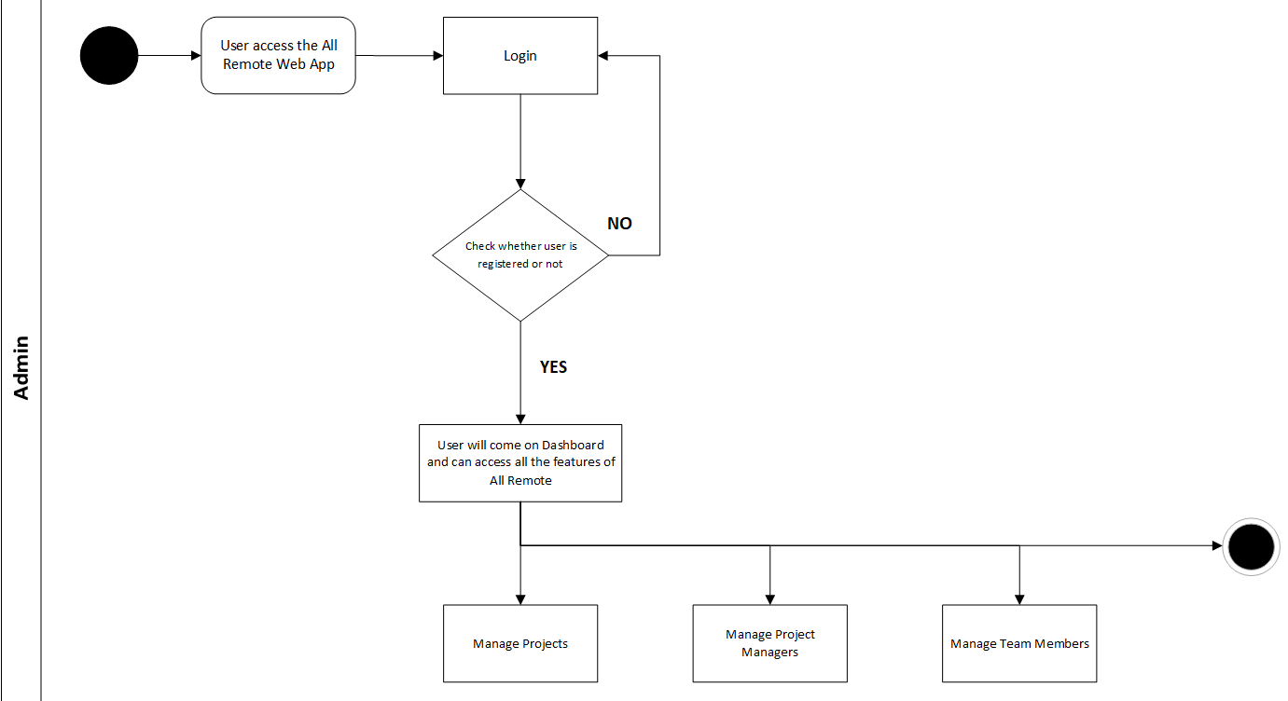
Flow Diagram
allRemote

Slide 10
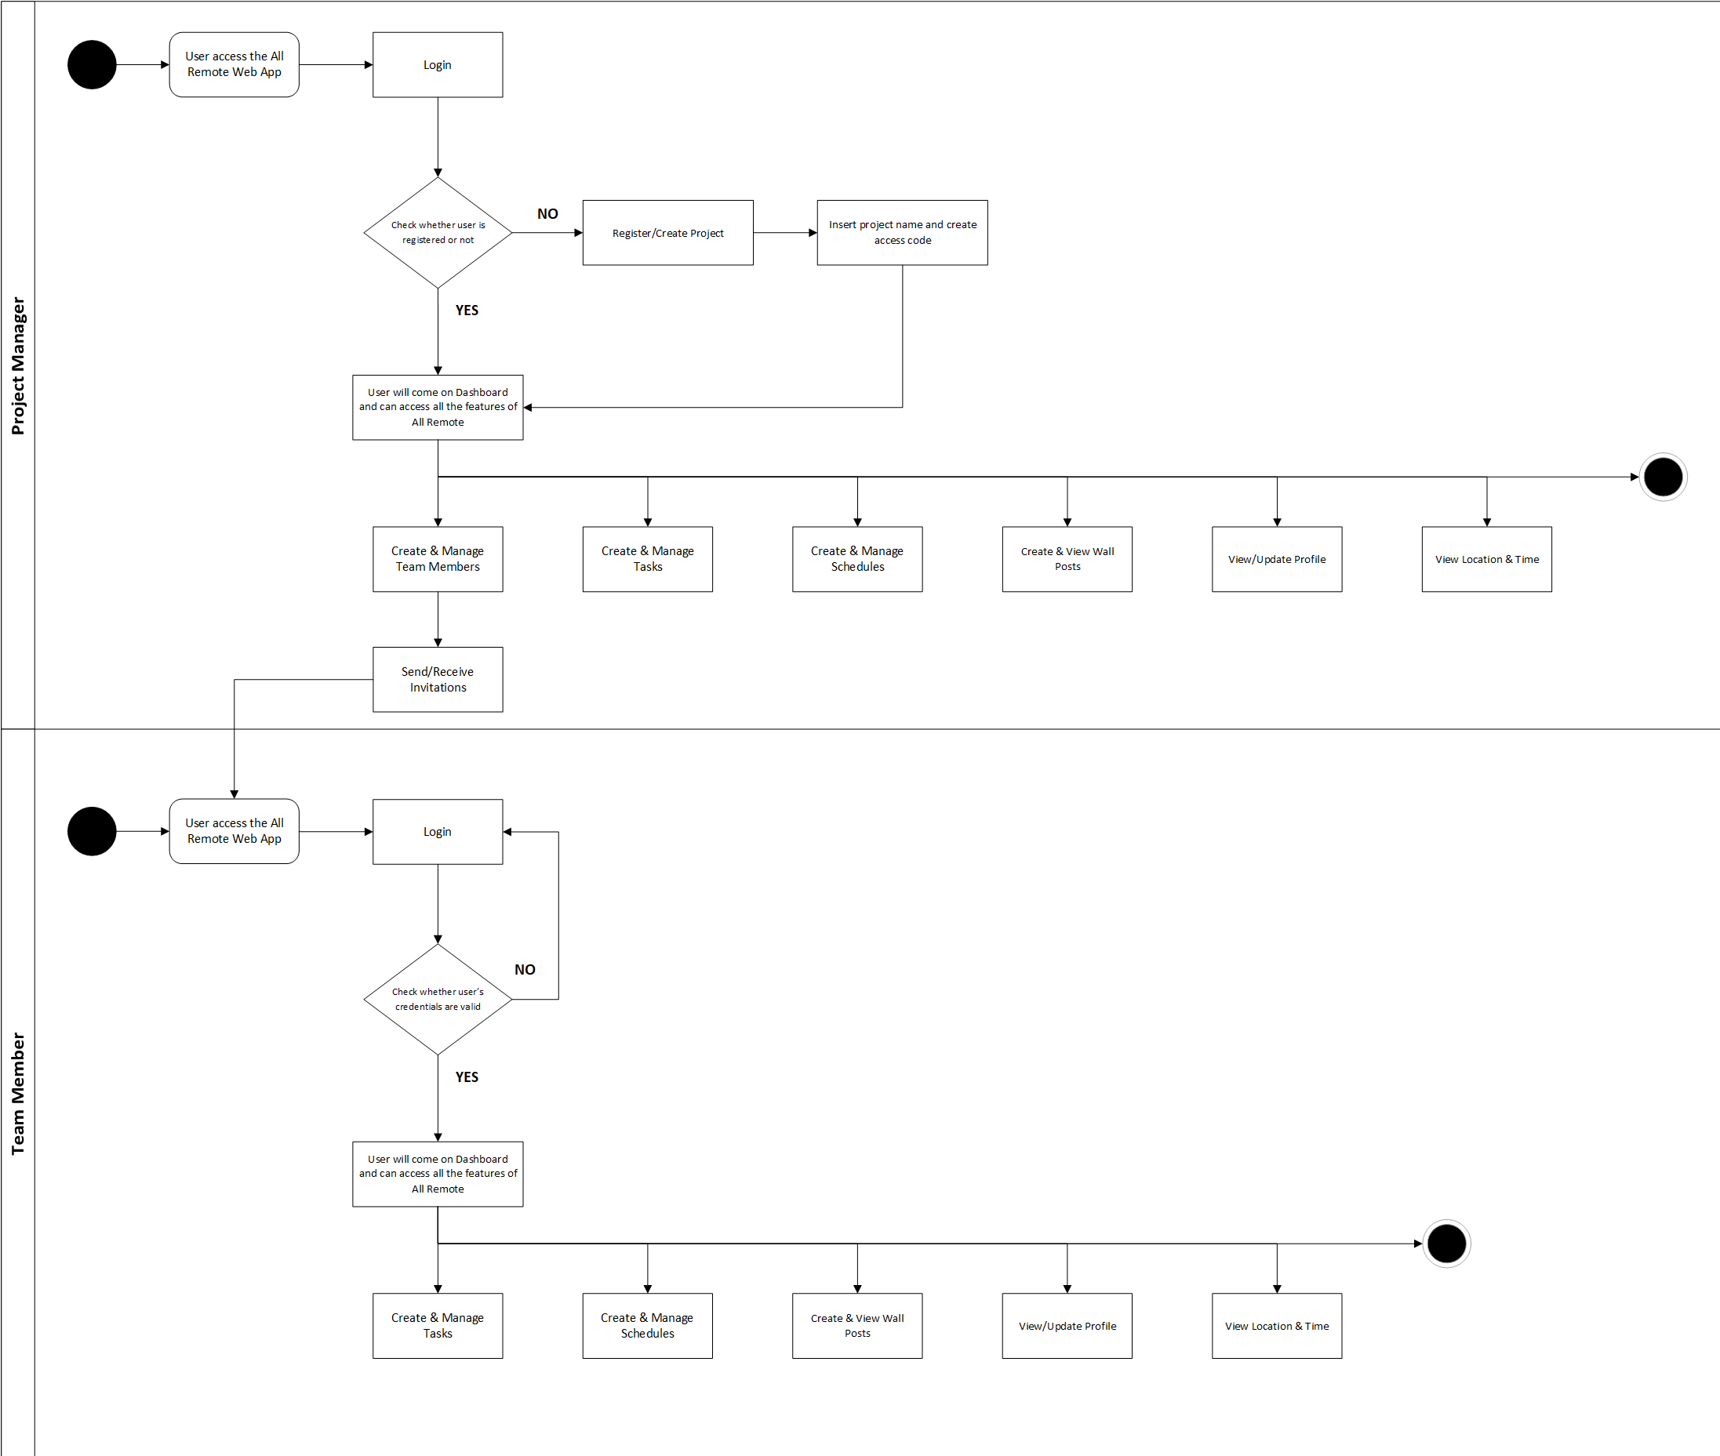
allRemote

Slide 11
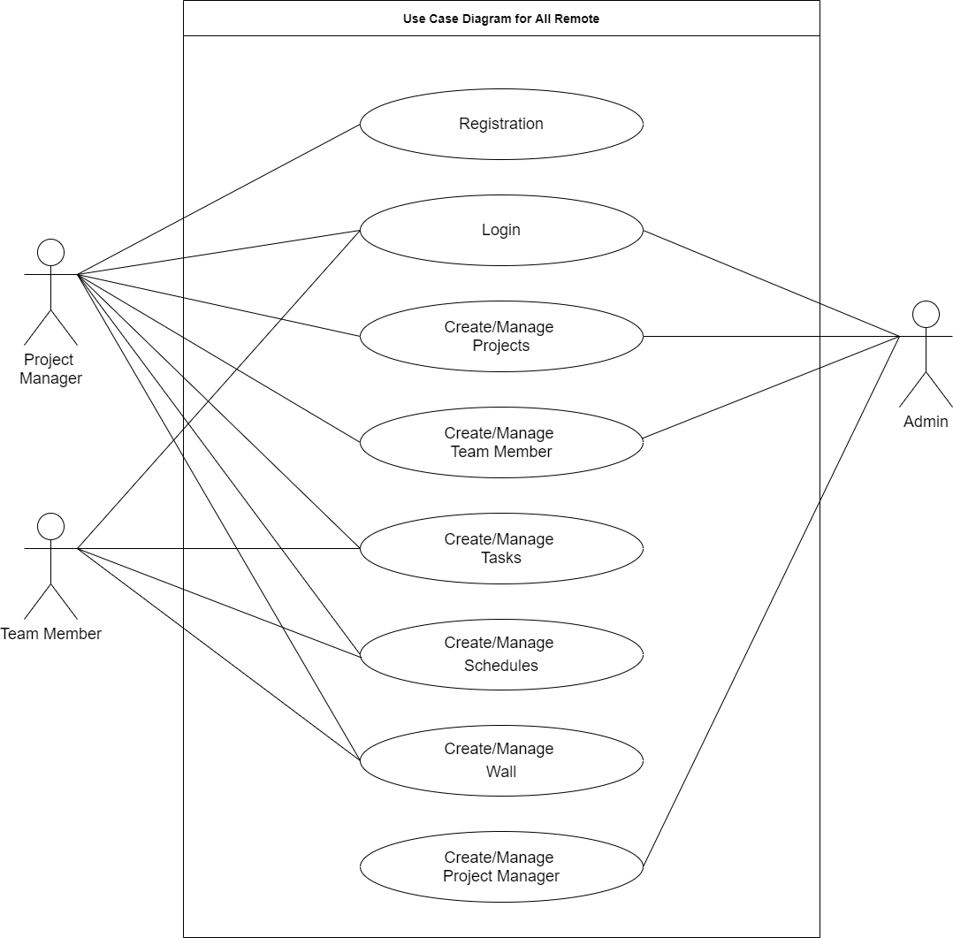
allRemote

Slide 12
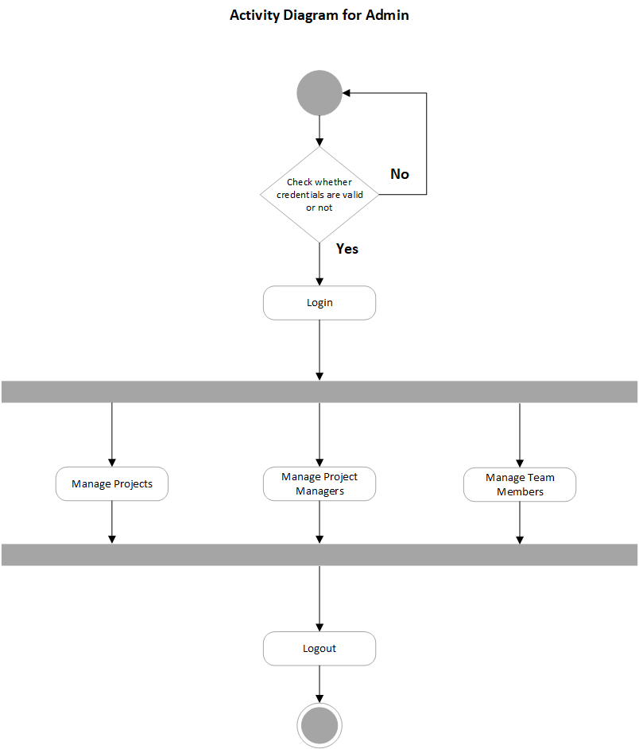
allRemote

Slide 13
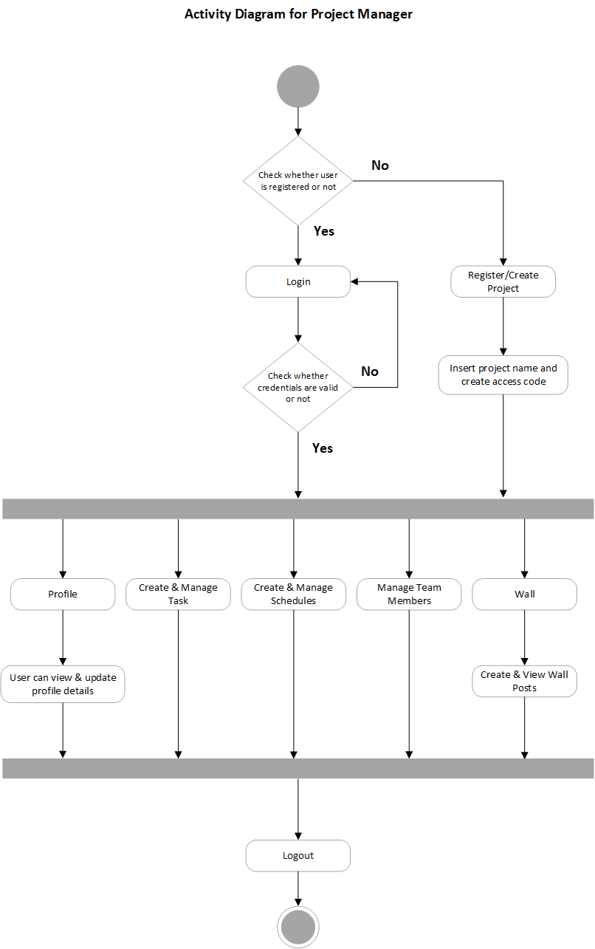
allRemote

Slide 14
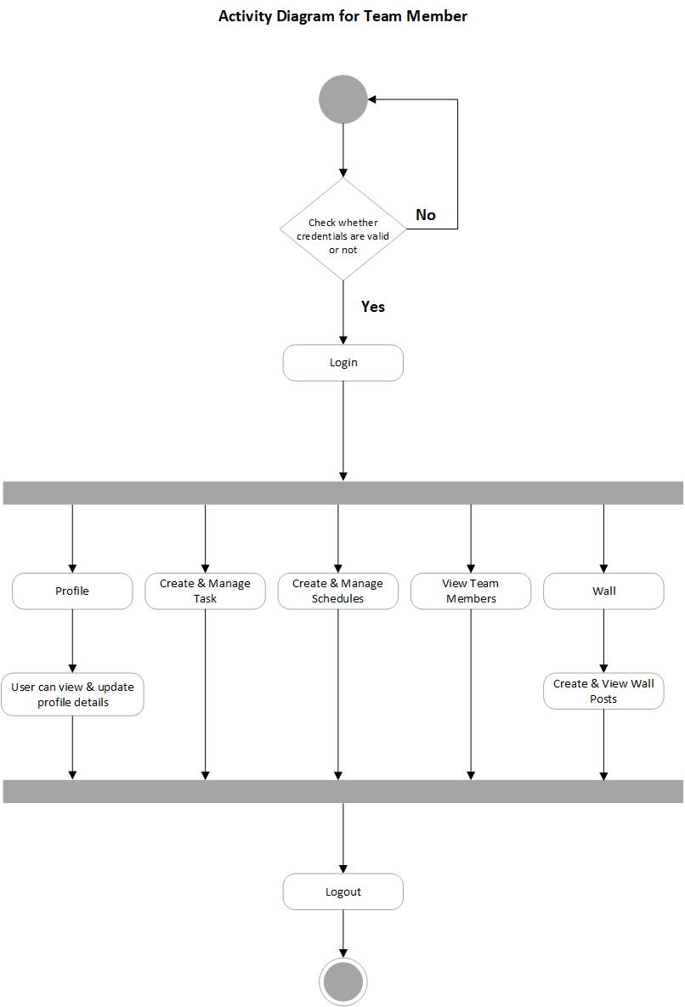
allRemote

Slide 15
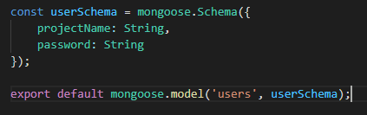
Collection Model
Project:- This collection will show details of total projects created in the application.
allRemote

Slide 16
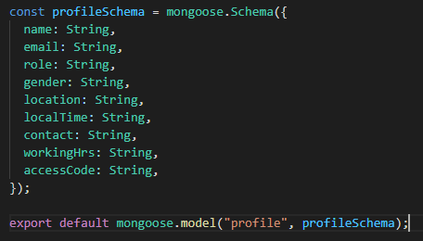
(2) Profile:- This collection will show details of the user profile.
allRemote

Slide 17
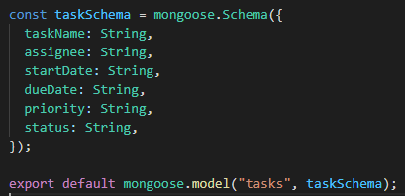
(3) Task:- This collection will show details of the tasks created in allRemote.
allRemote

Slide 18
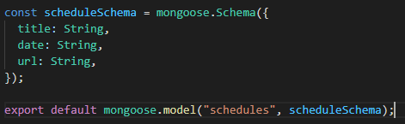
(4) Schedules:- This collection will show details of the schedules created in allRemote for the team.
allRemote

Slide 19
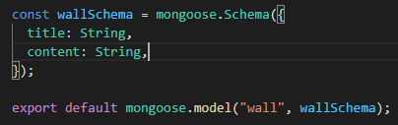
(5) Wall:- This collection will show details of the wall were team can create posts.
allRemote

Slide 20
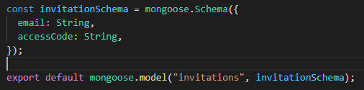
(6) Invitation:- This collection will show details of invitations send.
allRemote

Slide 21
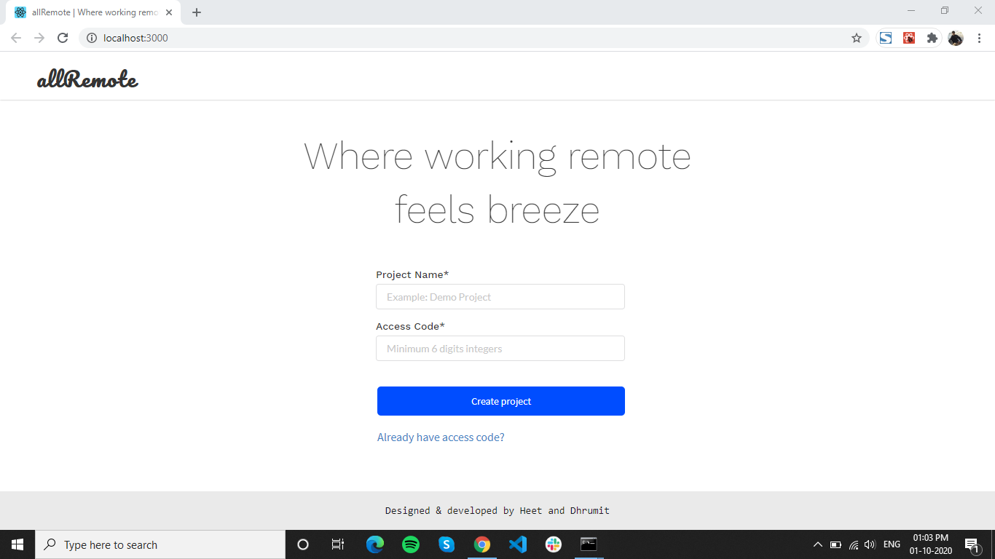
Screenshots
Sign Up Screen: This is snapshot of Sign Up for Project Manager
allRemote

Slide 22
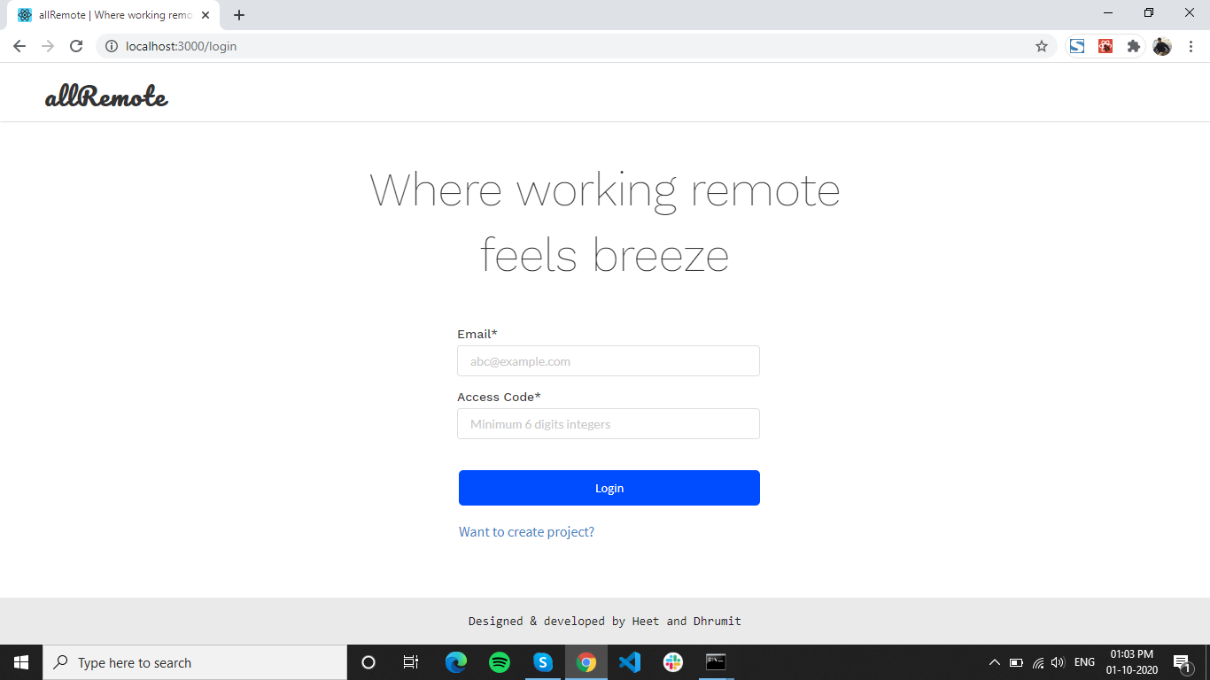
Sign In Screen: This is snapshot of Sign In screen for Project Manager & Team Member
allRemote

Slide 23
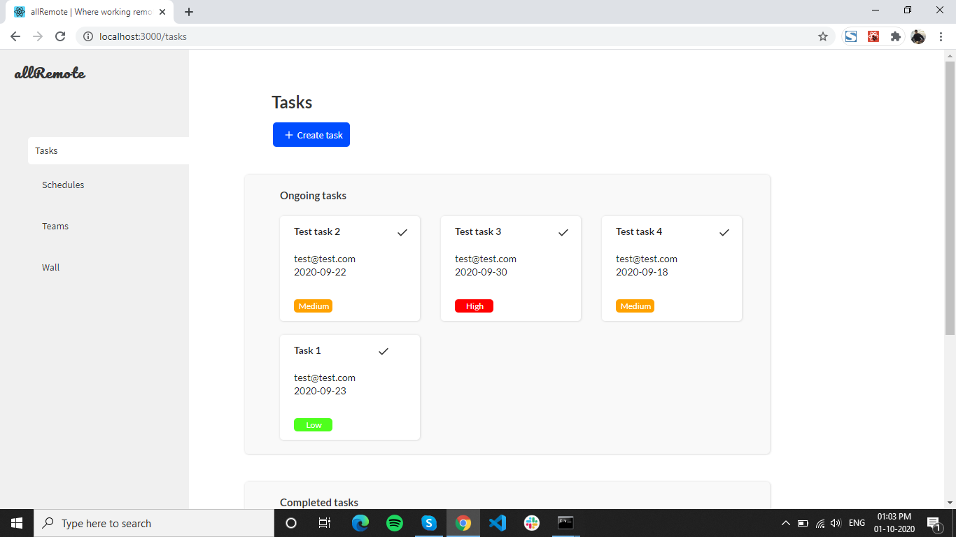
Dashboard: This is snapshot of dashboard for Project Manager & Team Member
allRemote

Slide 24
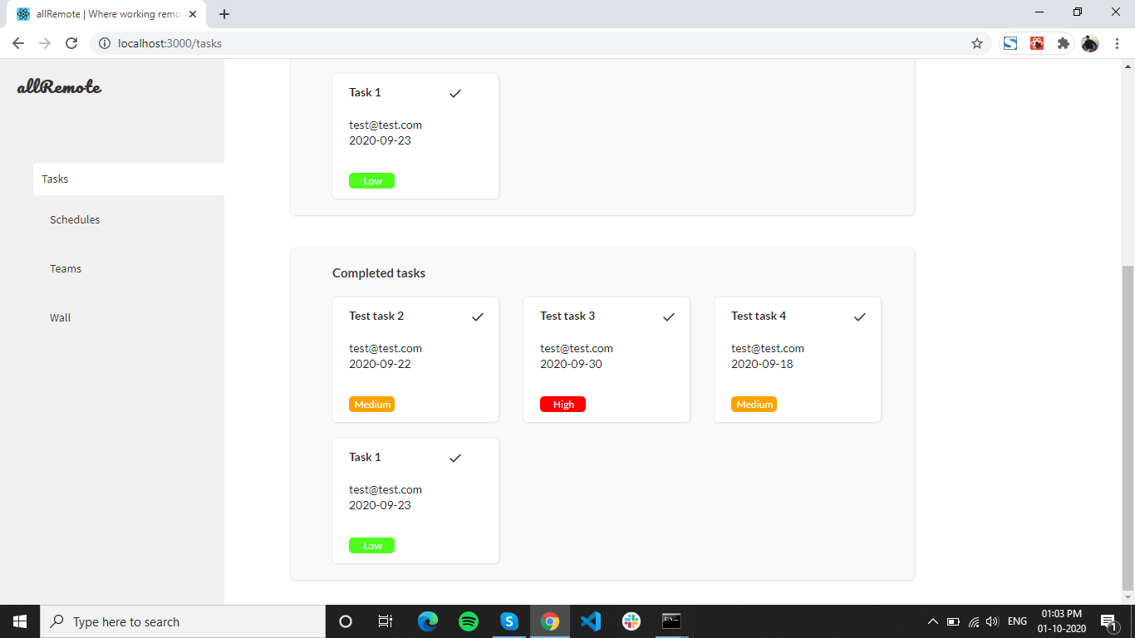
Task Screen: This is snapshot of tasks screen
allRemote

Slide 25
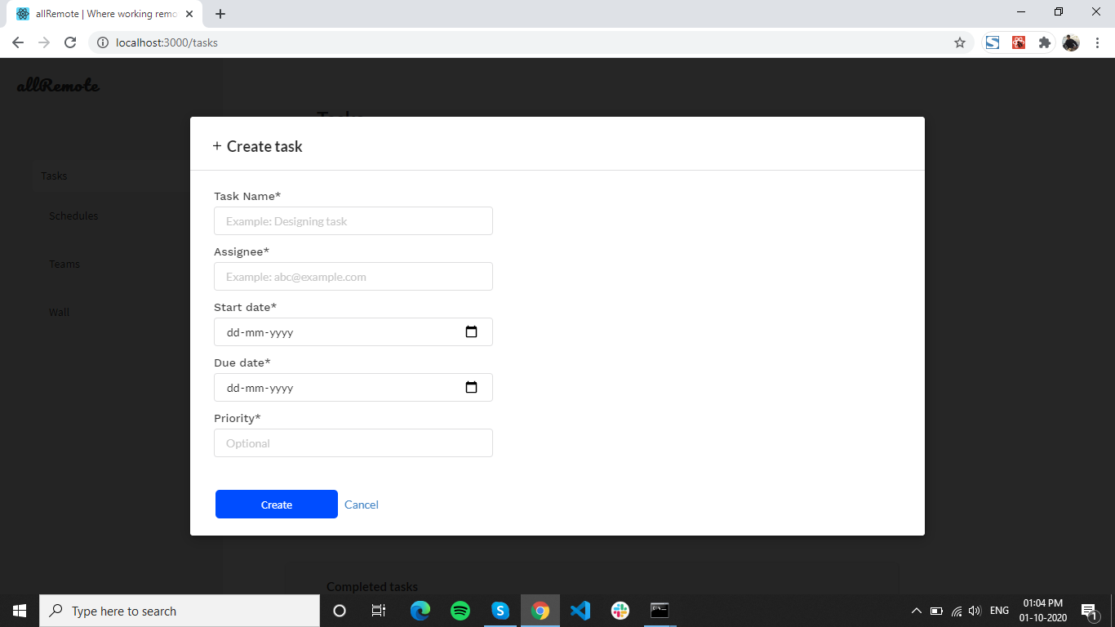
Task Create Screen: This is snapshot of create task
allRemote

Slide 26
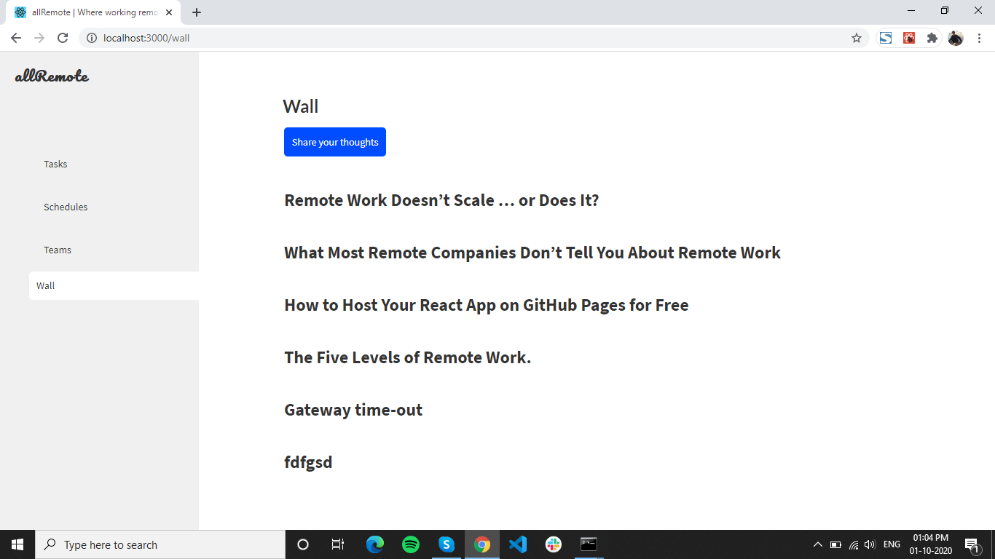
Wall Screen: This is snapshot of wall
allRemote

Slide 27
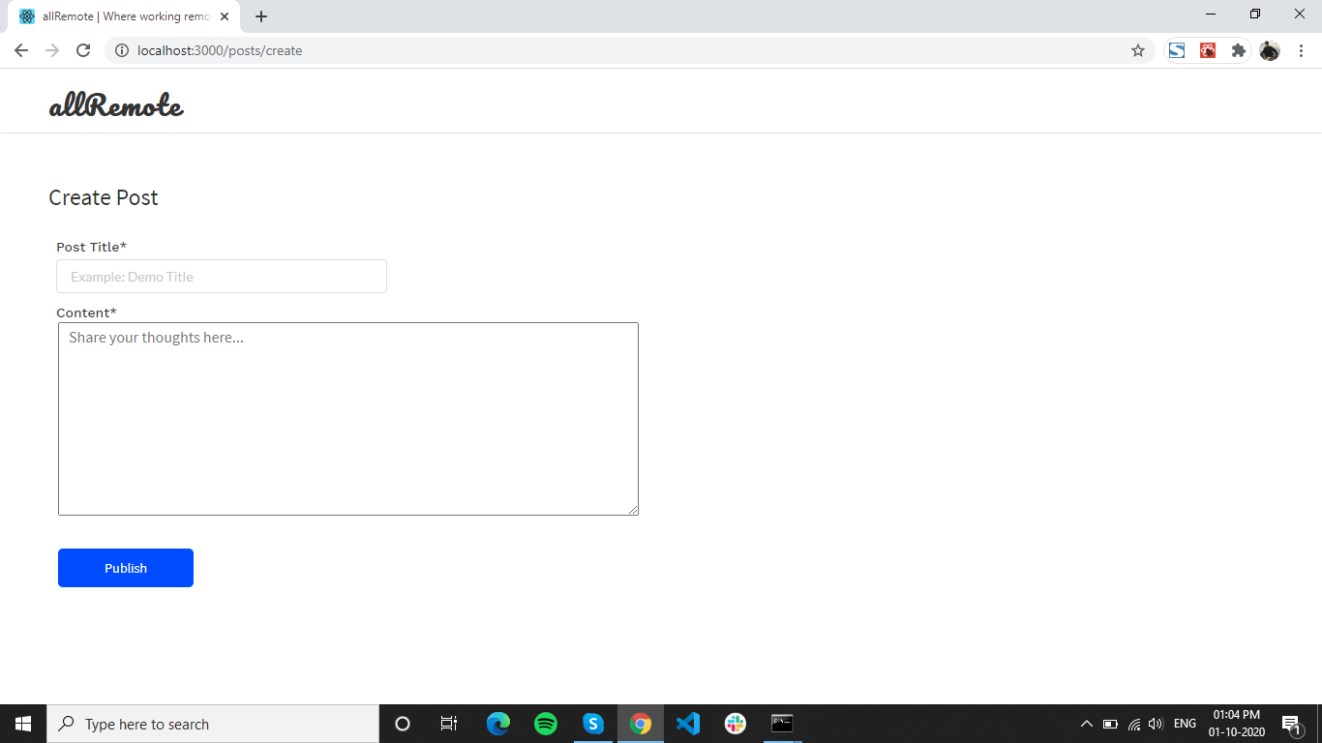
Create Post Screen: This is snapshot of Create Post for Wall
allRemote

Slide 28
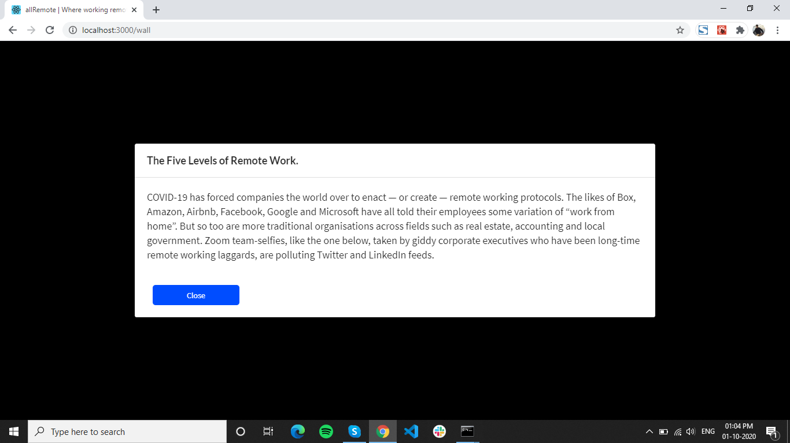
View Post Screen: This is snapshot of View Post on Wall Screen
allRemote

Slide 29
Future Enhancement
In future, we are planning to provide graphical representation for task and time tracking.
Also, we can show the locations of the team members in map like interface.
We would also like to offer an team member on-boarding via allRemote.
Gain insight into your team's work capacity by our Work Load feature.
And lastly we would like to add multi project management.
allRemote

Slide 30
Conclusion
This System has been developed with simple user interaction, efficient and less time consuming. Helpful to perform workflow of a project remotely. Provides easy, accurate, unambiguous and faster data access. With all Remote it is one platform, better teamwork.
allRemote

Slide 31
References
Websites
https://www.lucidchart.com/
(2) https://www.diagrams.net/
(3) https://www.monday.com
(4) https://www.basecamp.com
(5) https://www.reactjs.org
(6) https://www.formik.org/docs/
(7) https://www.react.semantic-ui.com
allRemote

Slide 32
Thanks!
allRemote

